Slide 1
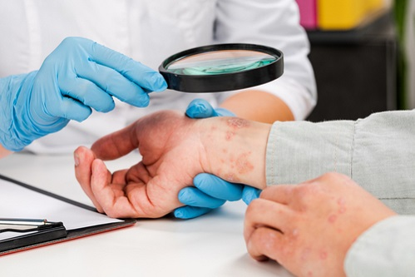


SKIN DISEASE IDENTIFICATION USING IMAGE ANALYSIS

Slide 2
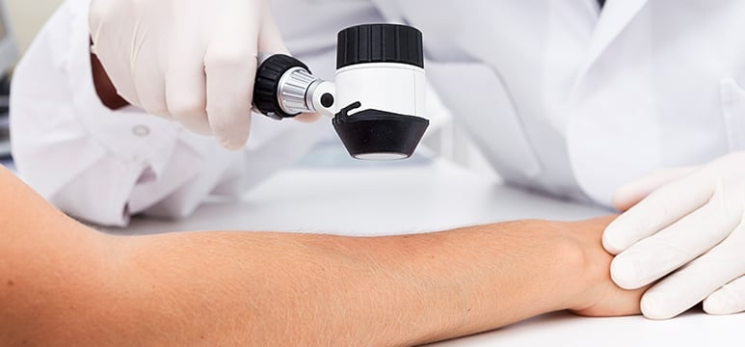
Yannam Sri Harshitha - 18UK1A05M7
Thouti Reddy Sudeepa- 18UK1A05M4
Poshala Sai Deepak - 18UK1A05L6
Vuppula Divya - 18UK1A05J0
TEAM MEMBERS

Slide 3
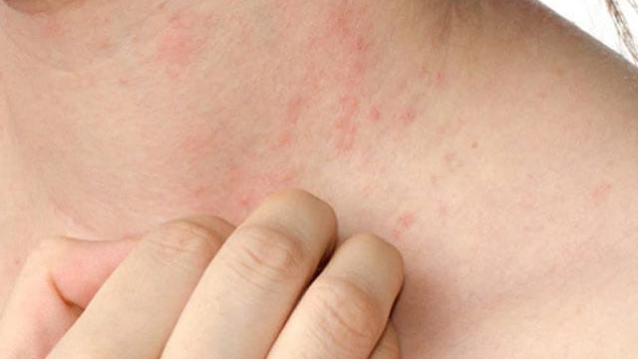
Problem Statement
Introduction
Procedure
Solution
Output
Summary
TABLE OF CONTENTS

Slide 4
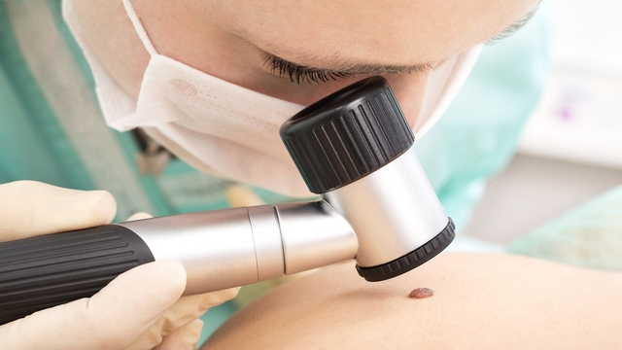
Now day’s skin diseases become more common problem in human life. Most of these diseases are dangerous and harmful, particularly if not treated at an initial stage. People do not treat skin diseases seriously. Sometimes, most of the people treat these infections of the skin using their own household methods. However, if these household treatments are not suitable for that particular skin problem then it would affect the skin. Also they may not be aware of severe problem of skin diseases. Skin diseases have tendency to pass from one person to another person easily. Hence it is very important to control it at earlier stage to prevent it from spreading in people.
PROBLEM STATEMENT

Slide 5
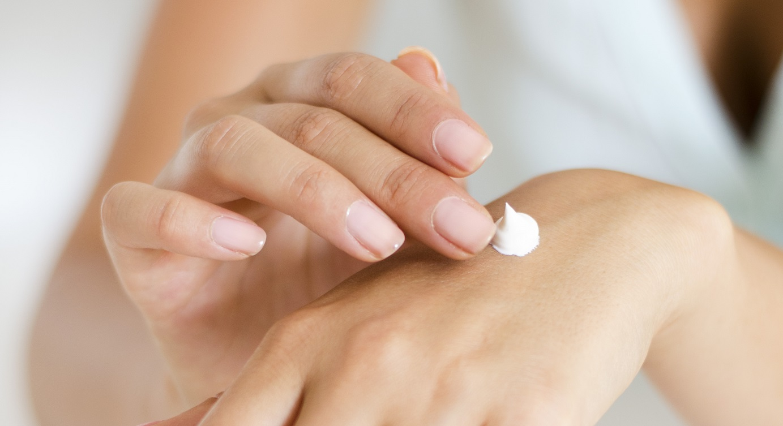
Skin disease is one of the most common and difficult disease for diagnosis because of its lack of awareness and ignorance. In many developing countries also people consult dermatologist for skin disease and prevention measures. The people are uncertain of the medicinal prescriptions provided by the dermatologist and there is no justification in the current system. Importance of skin disease without ignoring at the early stage is very important as skin plays a major role in protecting the human body against fungal and harmful bacterial infections. Thus identifying skin disease and diagnosis at the early stage is very crucial. Thus to provide feasible and efficient system and due to the emergence of smart phones, image processing based disease analysis is more demandful as this could provide promising results in less time. Utilization of camera technique, the people can provide the input and integration of image processing and machine learning techniques the respective skin disease is identified and diagnosis is recommended.
INTRODUCTION

Slide 6


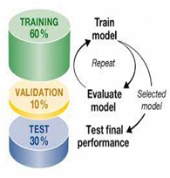



PROCEDURE
Collect the
dataset
Build the model by Training and Testing using CNN
Integrate the model built with flask in python file
Create the HTML and CSS for developing the webpage.
Display the output by selecting the Skin Disorder Image & predicting its disease type.

Slide 7
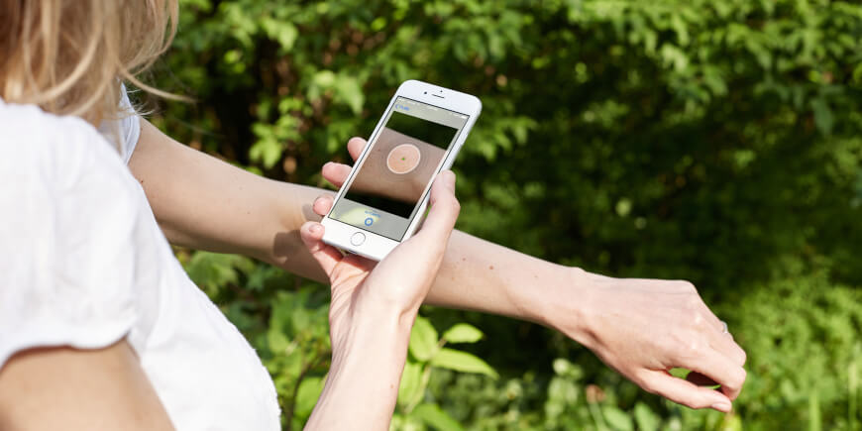
SOLUTION
Skin diseases are more common than other diseases. Skin diseases may be caused by fungal infection, bacteria, allergy, or viruses, etc. There are many techniques or methods developed in order to classify, identify and also to prevent the skin diseases. A convolution neural network (CNN) method is proposed in this study to boost the automatic identification of breast cancer by analyzing the Histopathological images. CNNs are applied to explore patterns in an image. CNNs are very effective at detecting objects in images. The proposed system uses CNNs to detect breast cancer from breast tissue images. The architecture of a CNN has 3 main layers, the convolutional layer, pooling layer, and fully connected layer. The first layer calculates the output of neurons which are linked with local regions. Each one is calculated by a dot product of weights and the region. For image inputs, typical filters are small in area such as 3 × 3. Pooling layer uses multiple filters to detect specific patterns which are in common. Pooling layer reduces number of parameters and dimensionality. Flatten layer is the process of converting all resultant 2 dimensional arrays from pooled featured map to a single long continuous linear vector. Further this flattened matrix from flatten layer is fed as input to fully connected layer to classify the image. After Classifying the image the further prediction is done in webpage by uploading an histopathology image which is trained previously in Convolutional Neural Network.

Slide 8
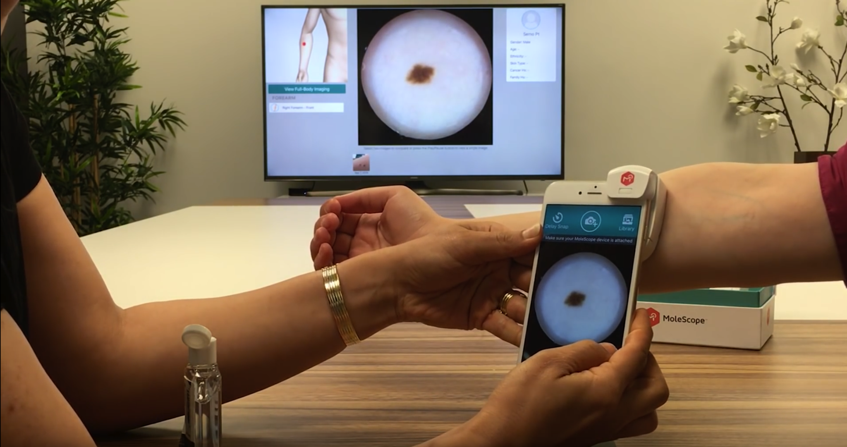
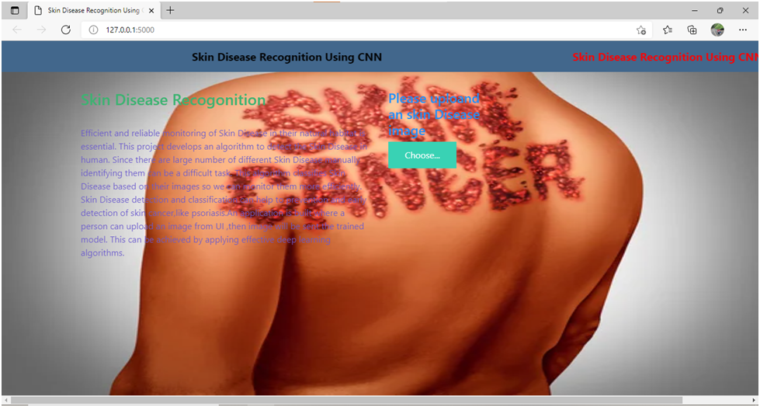
OUTPUT

Slide 9
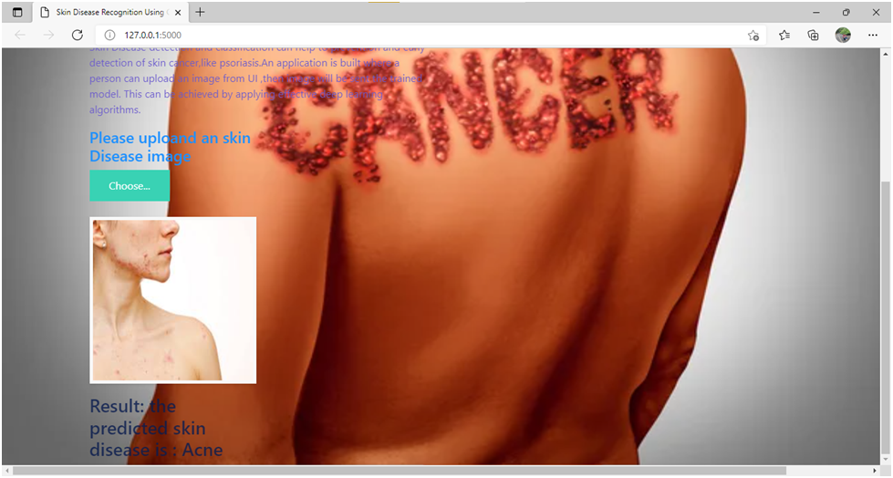
ACNE DISORDER

Slide 10
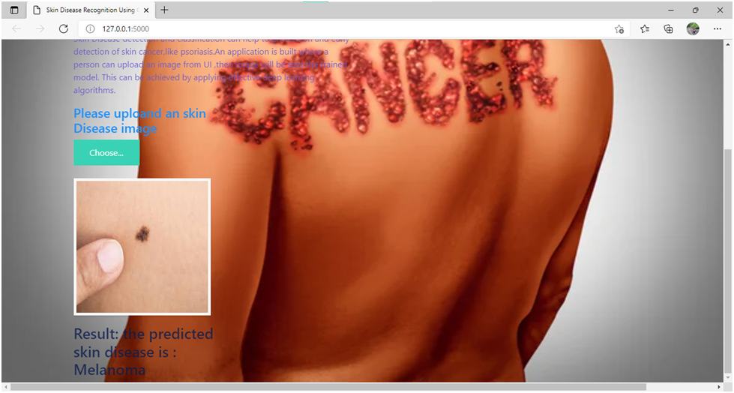
MELANOMA

Slide 11
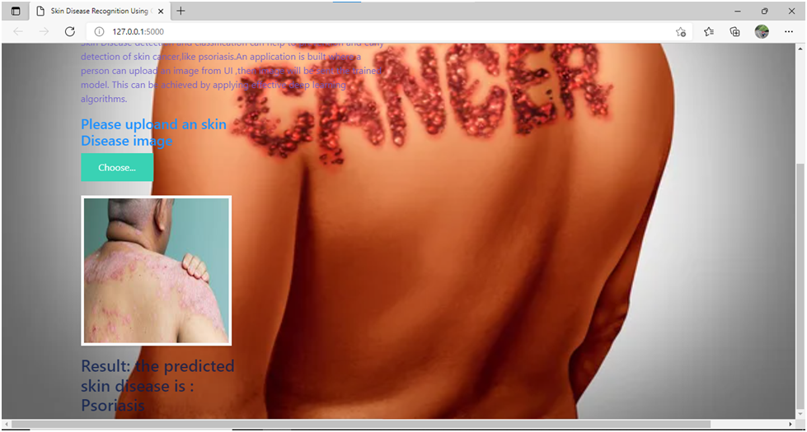
PSORIASIS

Slide 12
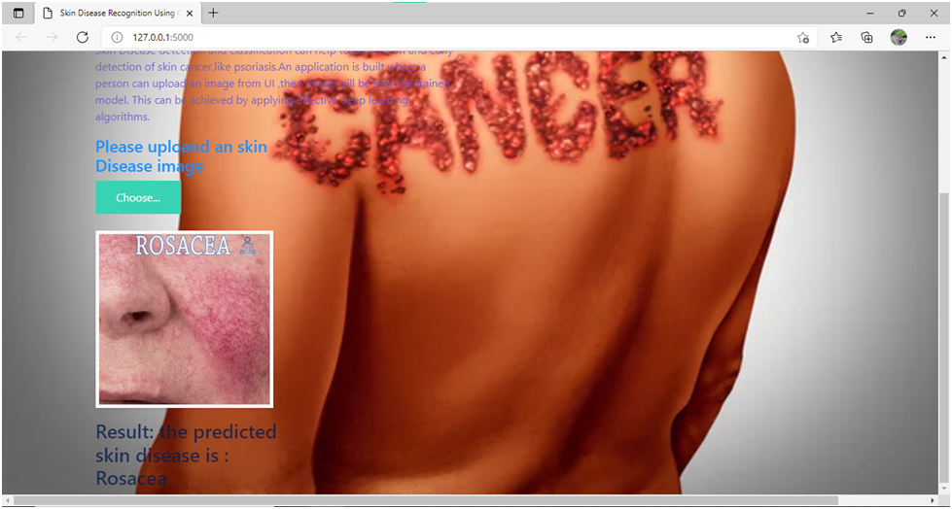
ROSACEA

Slide 13
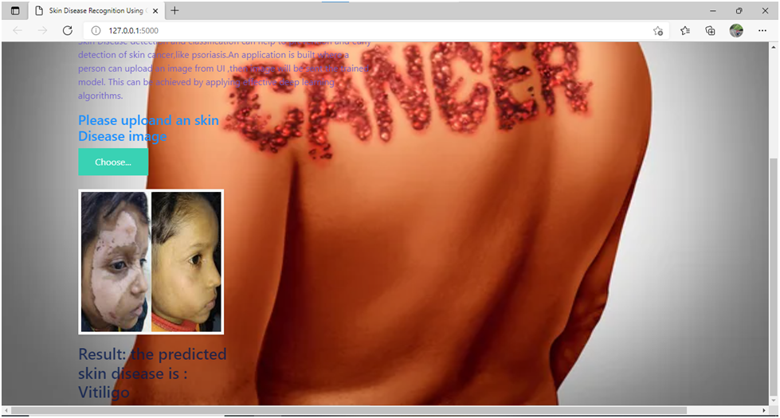
VITILIGO

Slide 14
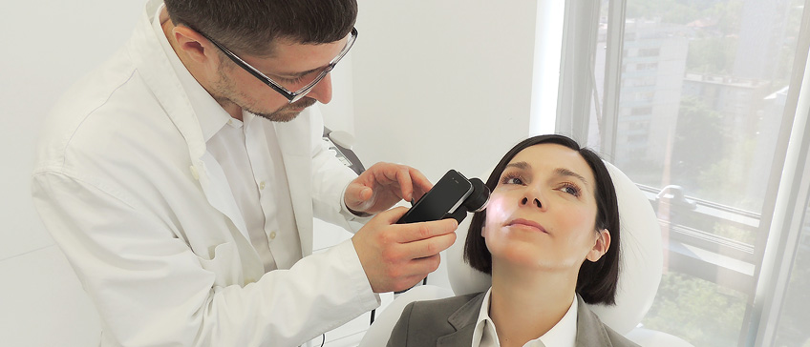
Our Problem statement is to predict the skin disorder type that a patient is suffering from using Image Analysis. Image Analysis is the process of understanding the image. For this purpose of Image analysis we use Convolutional Neural Network. In order to build a CNN model, initially we have to collect the images of different skin disorders. Next we train and test the images using CNN which classifies the types of Skin disorders i.e., Acne, Melanoma, Psoriasis, Rosacea, Vitiligo. Further by using Flask the python model is deployed and the prediction of skin disorder type is further rendered to html pages which displays its skin disorder type that patient is suffering from in a webpage.
SUMMARY

Slide 15
THANK YOU

